Slide 1
Module 1: Core Python & Data
Week: 4 Lecture: 15
DatE: 08/09/2025
Instructor: HAMZA SAJID

Slide 2
Today's Agenda
Setting Up Your Local Workshop
Step-by-Step: Installing the necessary tools.
Verification: Confirming your environment is ready.
Python Meets SQLite: A Simple Example
Understanding the 4 key steps of database communication.
Code Breakdown: connect, cursor, execute, commit, and close.
Deep Dive: Data Definition Language (DDL)
The SQL commands for building our database blueprint.
CREATE, ALTER, and DROP in detail.
Hands-On Lab: Build Your Database in VS Code
Write a Python script to create the entire blog schema, step-by-step.

Slide 3
Download & Install
Go to: https://sqlitebrowser.org/dl/
Download and run the standard installer for your OS (Windows 64-bit or Mac .dmg).
Follow the setup wizard, keeping the default options.

Slide 4
Verify the Installation
Open Command Prompt (Windows) or Terminal (Mac).
Type sqlite3 --version and press Enter.
You should see a version number. This confirms the engine is ready for Python!
Our Workflow:
We will write all our code in VS Code. We will only use the DB Browser for SQLite application to visually open our .db file and confirm our Python script worked.

Slide 5
Python Meets SQLite: A Simple Example
import sqlite3
conn = sqlite3.connect("test.db")
cur = conn.cursor()
cur.execute("CREATE TABLE IF NOT EXISTS users (id INTEGER PRIMARY KEY, name TEXT)")
cur.execute("INSERT INTO users (name) VALUES (?)", ("Alice",))
conn.commit()
cur.execute("SELECT * FROM users")
print(cur.fetchall())
conn.close()
This code creates a database, makes a table, adds one person, saves, reads the data back, and closes the connection. Let's break down the key commands.

Slide 6
CONNECT(), CURSOR() AND EXECUTE() commands
connect() - Open the Line
conn = sqlite3.connect("test.db")
What it does: It opens a connection to a database file. If the file doesn't exist, it creates it for you.
Analogy: Picking up the phone and dialing the database's number.
cursor() & execute() - Send the Message
cur = conn.cursor() and cur.execute(...)
What they do: The cursor is your messenger. The execute() command gives that messenger a specific SQL instruction to carry to the database.
Analogy: Writing a note (execute) and giving it to your messenger (cursor) to deliver.

Slide 7
Commit() and close() commands
commit() - Save Your Work
conn.commit()
What it does: This is the most important step! It permanently saves all the changes you've made (like INSERT or CREATE) to the database file.
Analogy: Hitting the "Save" button on a document. Without it, your work is lost.
close() - Hang Up
conn.close()
What it does: Safely closes the connection to the database.
Analogy: Hanging up the phone. It's good practice to always end the conversation cleanly.

Slide 8
What is Data Definition Language (DDL)?
Analogy: If your data is the furniture and people in a house, DDL is the construction crew that builds, modifies, and demolishes the rooms, walls, and floors.
DDL commands do not touch the data itself. They only define the structure where the data will live.
The three core DDL commands are CREATE, ALTER, and DROP.

Slide 9
DDL Example 1: The CREATE Statement
Purpose: To construct a new table from scratch, defining every column and its rules.
Common Data Types:
INTEGER: For whole numbers (e.g., UserID).
TEXT: For strings (e.g., Username, Email).
REAL: For decimal numbers.
Essential Constraints (The Rules):
PRIMARY KEY: Marks a column as the unique ID for each row.
FOREIGN KEY: Creates a link to a PRIMARY KEY in another table.
NOT NULL: Guarantees a column must have a value.
UNIQUE: Ensures every value in that column is different.

Slide 10
Example Query: Let's design a simple table to store products.
CREATE TABLE Products (
ProductID INTEGER PRIMARY KEY,
Name TEXT NOT NULL,
Price REAL,
SKU TEXT UNIQUE
);
Breakdown:
ProductID INTEGER PRIMARY KEY: An auto-incrementing, unique ID for each product.
Name TEXT NOT NULL: The product's name, which cannot be empty.
Price REAL: The price, which can have a decimal point.
SKU TEXT UNIQUE: A unique Stock Keeping Unit code for each product.

Slide 11
DDL Example 2: The ALTER Statement
Purpose: To change the structure of a table that already exists, without deleting it.
Lets you modify a table's structure without losing its data. The most common use is adding a new column.
Example Query: We decided we need to track the stock quantity for our products.
ALTER TABLE Products ADD COLUMN StockQuantity INTEGER DEFAULT 0;
Breakdown:
ALTER TABLE Products: Specifies which table we are modifying.
ADD COLUMN StockQuantity: Tells the database we are adding a new column named StockQuantity.
INTEGER DEFAULT 0: Defines the new column's data type and sets its default value to 0 for all existing and new rows.

Slide 12
DDL Example 3: The DROP Statement
Purpose: To completely and permanently delete a table, including its structure and all data inside it. Use with extreme caution!
A permanent, irreversible command that deletes an entire table and all its data.
Example Query: We've decided to stop selling products and want to remove the table.
DROP TABLE Products;
Best Practice: To avoid errors if the table doesn't exist, use IF EXISTS.
DROP TABLE IF EXISTS Products;

Slide 13
HANDS-ON LAB: PREPARING THE SCRIPT
Goal:
Write a Python script from scratch to create the entire blog database structure.
Tool:
VS Code for writing Python, and DB Browser for SQLite for visual verification.

Slide 14
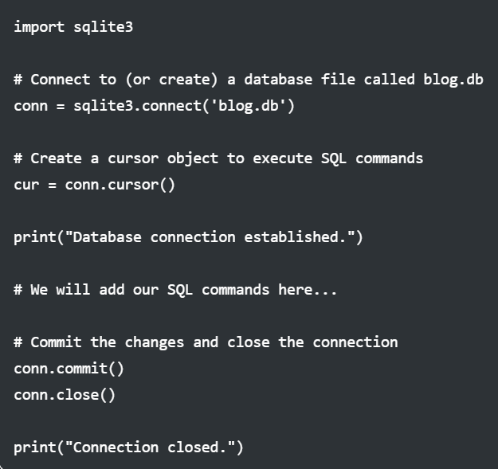
Step 1: Create the File and Basic Connection
In VS Code, create a new file named setup_database.py.
In the editor, type the following setup code:

Slide 15
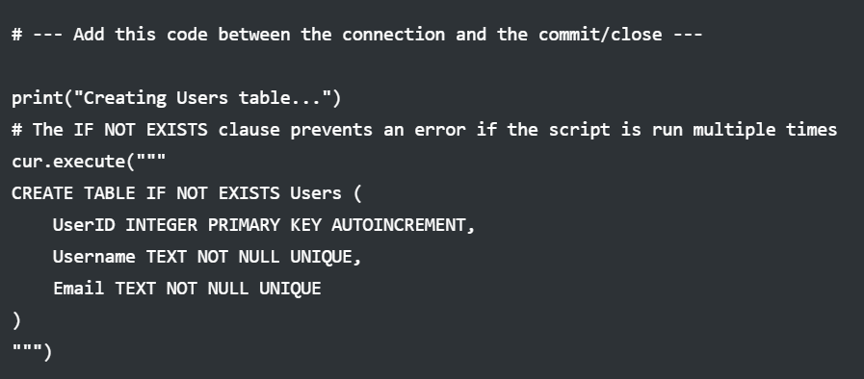
LAB STEP 2: CREATE THE Users TABLE
Task:
Define and create the main Users table.
In your setup_database.py script, add the following code in the middle section:

Slide 16
LAB STEP 2: CREATE THE Users TABLE continued…
Explanation:
This SQL command tells the database: "Build a table named Users. Give it a UserID that is an auto-incrementing primary key, a Username that must be unique text, and an Email that must also be unique text."
Run the script.
A blog.db file will appear. You can open it with DB Browser to see your new Users table!

Slide 17
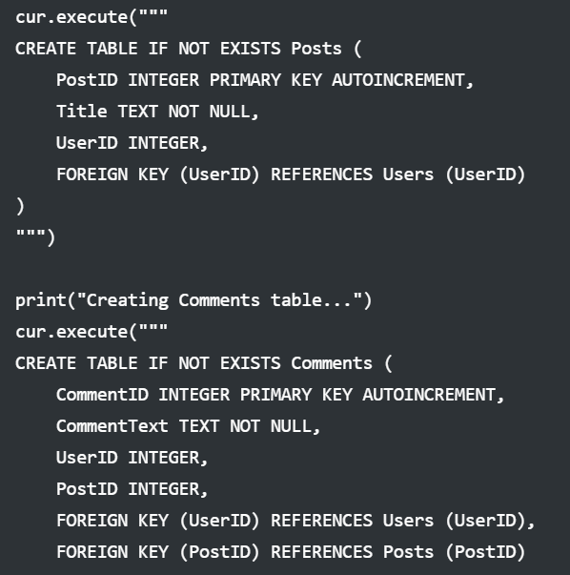
LAB STEP 3: CREATE THE Posts AND Comments TABLES
Task: Add the Posts and Comments tables and link them using Foreign Keys.
Add the following code right after the Users table creation in your script:

Slide 18
LAB STEP 3: CREATE THE Posts AND Comments TABLES continued…
Explanation:
The FOREIGN KEY constraint creates a formal link. It ensures that any UserID in the Posts table must already exist in the Users table. This enforces data integrity.
Run the script again.
Now, when you check your blog.db file in DB Browser, you will see all three tables.

Slide 19
BONUS CHALLENGE
Challenge 1: The "Reply-To" Feature
Task: A great blog allows threaded comments (replies to other comments). Let's add this feature! Modify the Comments table so a comment can be a reply to another comment.
Instructions:
Create a new script, modify_blog.py.
Connect to blog.db.
Use ALTER TABLE to add a new column called ParentCommentID of type INTEGER.
This new column should be a FOREIGN KEY that points back to the CommentID of the very same table (Comments). This is called a self-referencing relationship.
Challenge 2: The "Draft" Status
Task: We don't want posts to be public immediately. Add a Status column to the Posts table that can only be 'draft' or 'published', with 'draft' as the default.
Instructions:
In your modify_blog.py script, use ALTER TABLE on the Posts table.
Add a column Status of type TEXT.
Add a DEFAULT 'draft' constraint.
Add a CHECK (Status IN ('draft', 'published')) constraint. This powerful rule prevents any other value from ever being inserted into this column.

